Slide 1

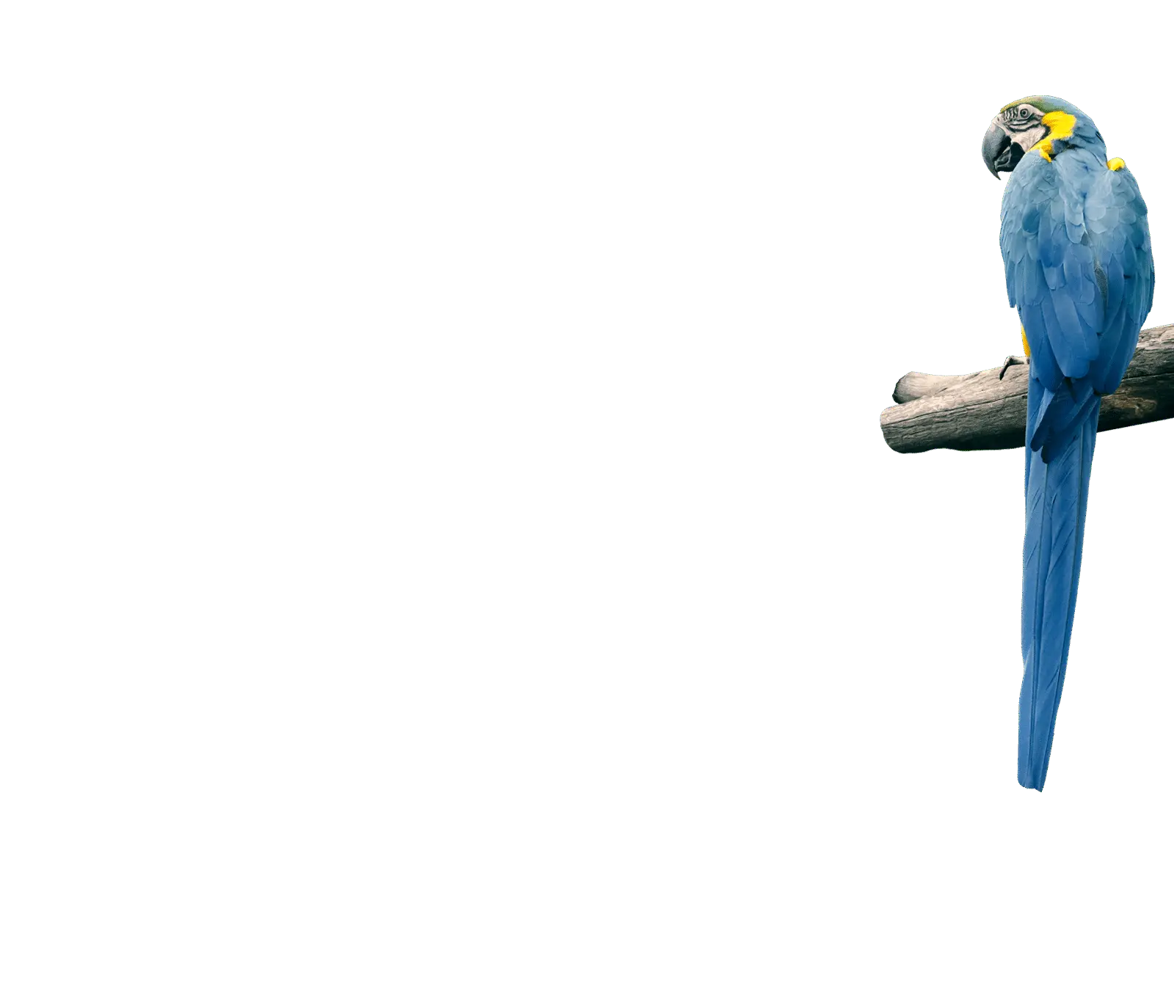
Optimal Birdwatching in Massachusetts:
Species Frequency Forecasts &
Birding Activity Analysis
Phase 2 - Final Presentation
Team 2: Michael Aldoroty, Neil Ghosh, Nhat Pham, Hajera Siddiqui
DS 5500
Notes:
Give updates on our

Slide 2
Objectives
Detection rate forecast
Improve performance and speed
Scale model to all 465 birds in 14 counties
Environmental regressors
Semi-automated pipeline
Birding activity analysis
Notes:
Michael

Slide 3
Forecast Models

Slide 4
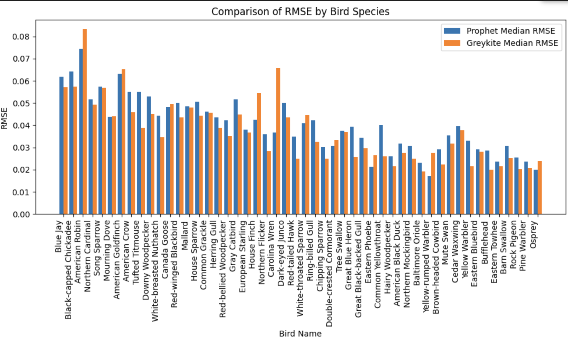
Prophet vs Greykite
Testing on 50 species: Fine-tuned hyperparameters (trend, seasonality etc.) for both models, employing grid search and CV for optimal performance, parallel processing to improve computational efficiency
Selected Prophet for final scale-up
3x faster than Greykite
Comparable accuracy
Notes:
Michael
After testing on 50 species, selected Prophet for final scaling due to comparable accuracy and faster runtime

Slide 5
Final Prophet Model
Streamlined dataset to Prophet’s requirements
Employed logistic regression: carrying capacity = 1, floor = 0
Applied exponential smoothing to reduce noise
Data
preparation
Focused on changepoint & seasonality prior scale
Grid search & CV for optimal parameter selection based on minimum RMSE
Parallel testing with multiprocessing library, “Pool” object
Parameter
tuning
Ran each model with best changepoint parameter for 2-yr forecast
Compiled forecast & actual data for Tableau dashboard
Record RMSE and MAE values for model assessment
Model
execution
Testing
Notes:
Michael
To get our model ready for the final dataset, we employed multiple techniques to make sure it was prepared
We made sure the dataset was compatible with prophet’s requirements.
Included logistic regression and with saturation points like adding capacity of 1 and floor of 0
For parameter tuning:

Slide 6
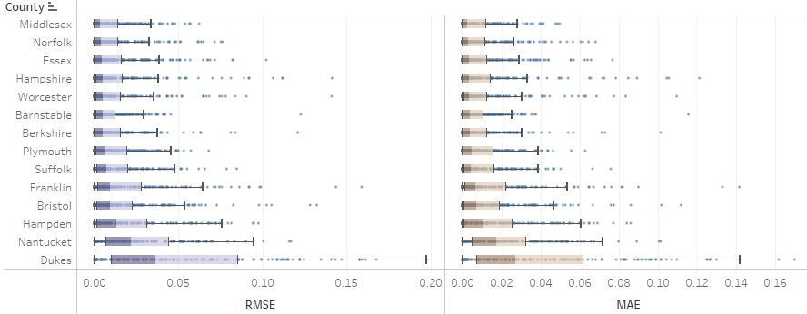
Results
Total runtime (6510 models) is 1 hr 30 min
11.6 seconds/ species vs. 27.6 seconds/ species in previous version
Satisfactory accuracy
Metric | Min | Max | Median
RMSE | 2.27e-9 | 0.197 | 0.007
MAE | 1.36e-9 | 0.170 | 0.005
Model performance varies across counties
Notes:
Hajera
Runtime
The performance of the models was satisfactory, with a median RMSE of 0.007 and median MAE of 0.005 .
As can be seen in the RMS and MAE boxplots for each county in the figures below, model performance varies across different counties.,
Models for densely populated counties like Middlesex, Norfolk, and Essex have higher accuracy and this is likely due to higher number checklists submitted and better data collection happening there
Counties with rich nature landscapes like Barnstable and Hampshire also have good model performance.
But In contrast, models for Nantucket and Dukes islands, have high variability in performance, likely because they are less accessible hence limited data

Slide 7
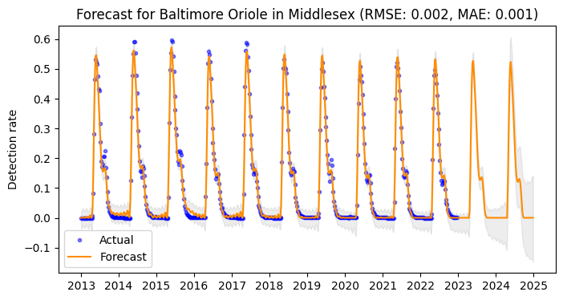
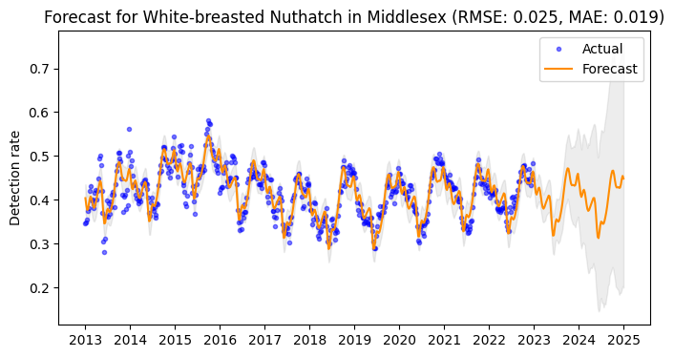
Results
High predictive accuracy for migratory birds because of pronounced seasonal patterns
Lower predictive accuracy for resident birds due to variable detection patterns, underreporting, complex behaviors
Fig 1. Forecast for a migratory bird
Fig 2. Forecast for a resident bird
Notes:
Hajera
Model performance also varies across species.
The model has very high predictive accuracy for migratory birds which is likely due to their pronounced seasonality patterns. An example is the Baltimore Oriole in this graph with the 0.002 rmse and 0.001 mae.
Models for resident, year-round birds have lower accuracy, possibly due to their widespread presence resulting in variable detection patterns and user underreporting. An example is the White-breasted Nuthatch. As you can see, the forecast has higher RMSE and a wider confidence interval than the Baltimore Oriole

Slide 8
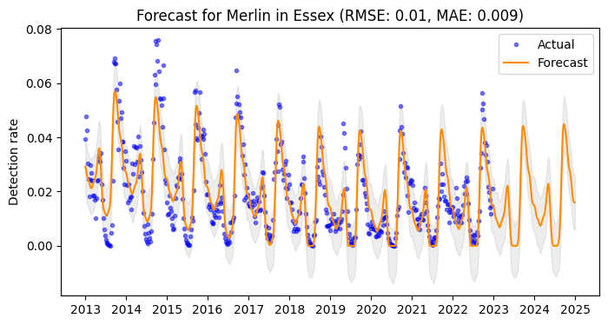
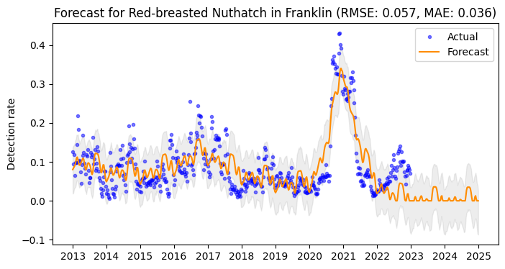
Results
Performs well with elusive, hard-to-detect species (falcons, owls)
Captures seasonality and trends well, especially changes that occur gradually; struggles with abrupt fluctuations
Fig 3. Forecast for an elusive bird
Fig 4. Forecast with changes in trend
Notes:
Hajera
3. The model also performed well with species that are more elusive, such as falcons and owls. As you can see, Merlin has very low detection rate, yet the model still performs well.
4. Overall, the model captured trends and seasonality very well, particularly when changes occurred gradually, as seen with the increase for the Red-breasted Nuthatch in Franklin in 2020-2021. However, it struggles with abrupt, short-term fluctuations, like the sharp and small rise in 2022 (in the same figure)

Slide 9
Regressors
We tested two regressors on the final Prophet model: average temperature and precipitation; data retrieved from the National Centers for Environmental Information
Main challenge was sourcing a dataset that matched the weekly time scale of our eBird data. Data from NCEI was aggregated on a monthly basis, so four weekly eBird data points per month had the same temperature and precipitation value
County | Common Name | RMSE
 |  | No Regressor Model | Regressor Model
Barnstable | Northern Cardinal | 0.0419 | 0.0422
Barnstable | Tufted Titmouse | 0.0428 | 0.0443
Essex | Northern Cardinal | 0.0435 | 0.0442
Essex | Tufted Titmouse | 0.0419 | 0.0449
Notes:
Neil
Our research revealed that birds' migratory and movement behaviors are influenced by varying environmental conditions, and so incorporating relevant regressors into the Prophet model will allow us to better capture these relationships, and improve our predictions.
The two environmental regressors we used were average temperature and precipitation. These metrics were sourced from the NCEI.
As seen from the table above, the inclusion of temperature and precipitation as regressors in the Prophet model resulted in a slight increase in RMSE. This could likely be attributed to the mismatch in data aggregation levels: the NCEI dataset is monthly, while eBird data is weekly, causing identical regressor values for four data entries within the same month. Because the regressors did not enhance the model, we decided to exclude them from the final model iteration.

Slide 10
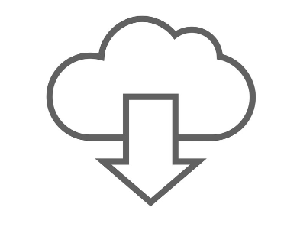


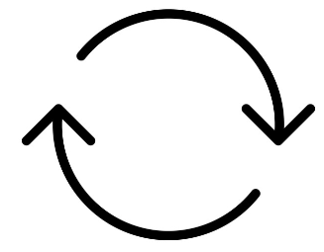

Automation Pipeline
Download latest data (yearly)
Data cleaning in R, Python
Merge new entries into a rolling 10-year dataset for
model training
Retrain forecast models with new data
Update analyses to reflect latest patterns
Sync and display updated results on Tableau dashboard
Notes:
Michael

Slide 11
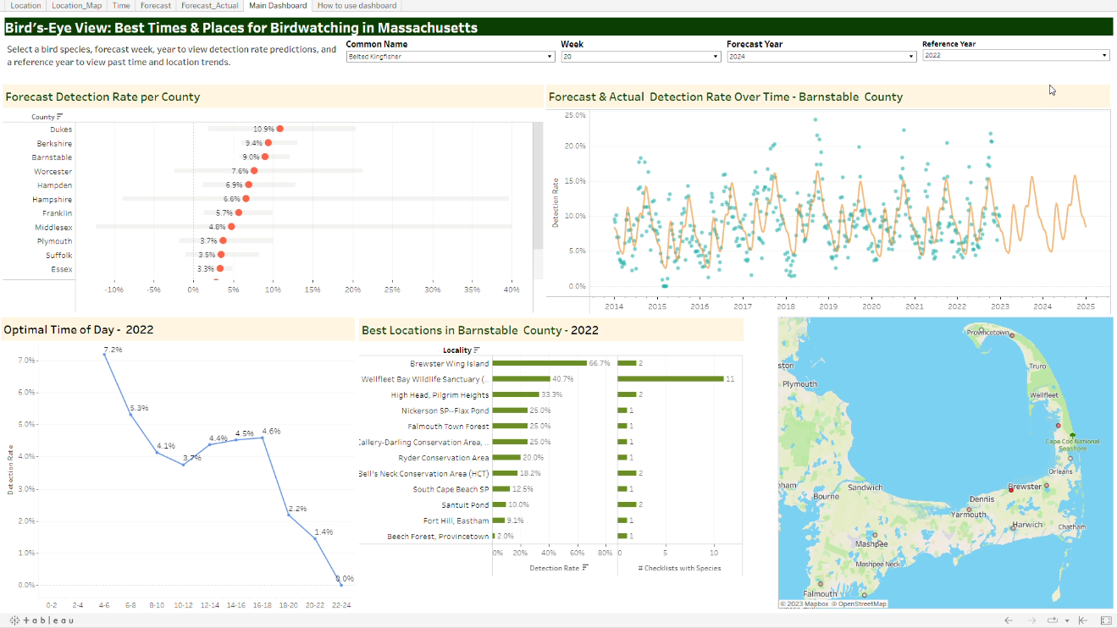
Updated Dashboard
https://tabsoft.co/3uFSm5S
Notes:
Finally, we updated the Tableau dashboard to display the forecast and descriptive analysis results for all species
Added a user guide and a demo video as well.

Slide 12
Birding Activity Analysis

Slide 13
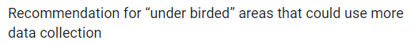
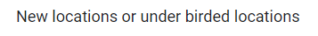
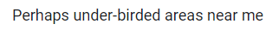
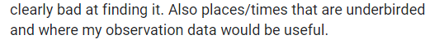
Motivation
User survey
Objective: identify under-birded and heavily birded areas to guide birdwatchers and support conservation efforts
Data: 2022 eBird records, American Birding Association, MA Avian Records Committee
Notes:
Nhat
We also created an analysis on birding activity across different areas in MA in different times of the year. The motivation came from our survey and interviews with local birdwatchers who would like to discover less-known birding spots that could benefit from more data collection. Our analysis aims to identify such under-birded areas as well as over-birded locations.
We used 2022 eBird records and some additional sources

Slide 14
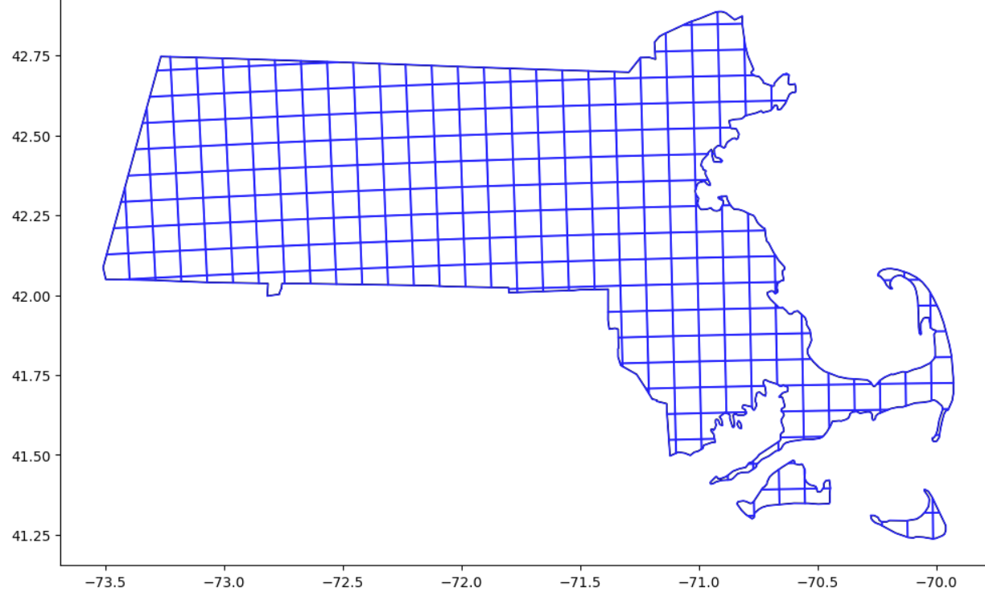
Descriptive Analysis
Segmented MA into 8km x 8km grid cells
Identified 4 key metrics, including rare species count, from eBird and external sources
Assigned checklists to grids & computed metrics for each month
Compare areas on species diversity & birding activity, aggregating metrics into 2 scores:
Diversity score = 0.4* median_num_species + 0.6* num_rarebirds
Popularity score = 0.4* num_checklists + 0.6* unique_observers
Area categorization:
 | Popularity | Diversity
Underbirded | low | high
Heavily birded | high | low
Popular | high | high
Low interest | low | low
Not enough info | n/a | n/a
Notes:
Nhat
To define comparison areas, we divided MA into 8x8km grid cells, each treated as a separate area. The size of the cell was refined through testing and consultation with an expert birder.
To evaluate birding activity within each area, we've selected four key metrics: checklist counts and unique observer counts to determine the area's popularity, alongside median species per checklist and the count of rare species to reflect the area's biodiversity. eBird data lacks information on bird rarity. So we gathered this data from two other sources, and also used the historical detection rates from our eBird data to compile a list of rare species.
After defining key metrics, we aggregated eBird data in 2022 at checklist level, assigned each checklist to a grid cell using its location coordinates, then calculated the selected metrics for each cell on a monthly basis
Then for each area, we calculated a birding popularity score and a species diversity score. The scoring method is very straightforward, with each score being the weighted sum of 2 previously mentioned metrics. The weights were assigned based on input from an expert birder who assessed the importance of each metric for the respective scores.
Next, we classify areas into five categories: Underbirded if they have low popularity score, but high diversity score, indicating they are not frequented by birdwatchers despite a rich variety of species.
"Heavily Birded" for locations that are popular among birdwatchers yet exhibit low species diversity.
"Popular" for those areas that score high in both popularity and species diversity.
"Low Interest" for areas that attract few birdwatchers and also have low species diversity,
and Not enough info for areas where data is scarce with fewer than 3 checklists submitted.

Slide 15



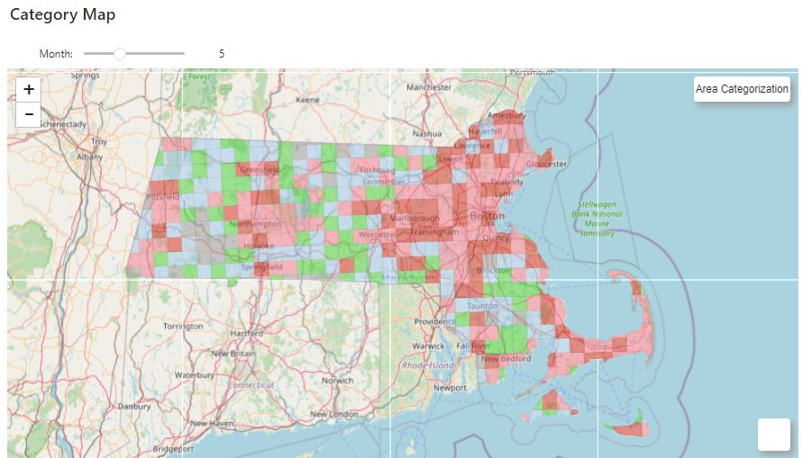
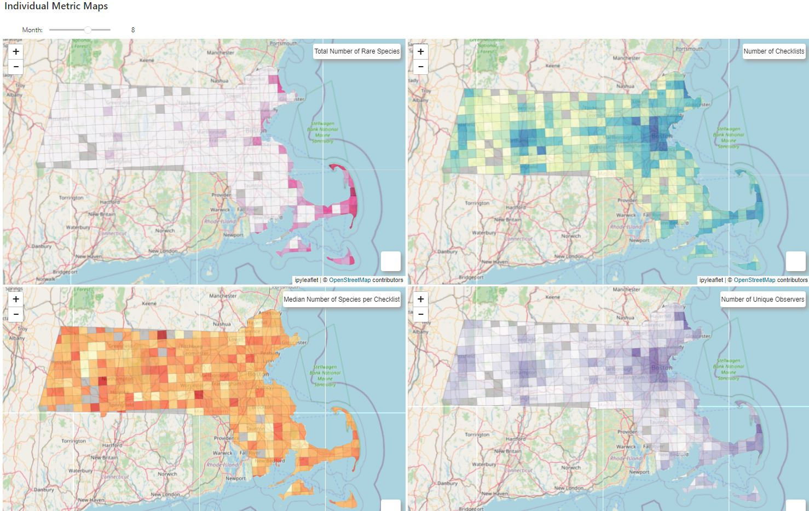
Visualization
Choropleth maps:
Slider to capture month-specific birding trends
View maps: https://bit.ly/3R7xhZH
Notes:
Nhat
We then created five interactive choropleth maps within a Jupyter Notebook environment using packages for spatial data and for creating interactive leaflet maps.
To share these maps publicly: we first converted the notebook outputs into a standalone application using the Voila package, then we used Binder, a free service that builds a Docker image from our GitHub repository, to host the notebook in a live environment.

Slide 16
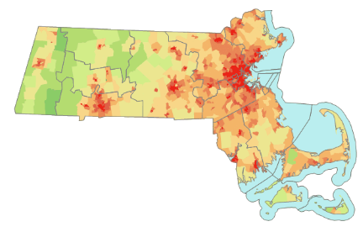
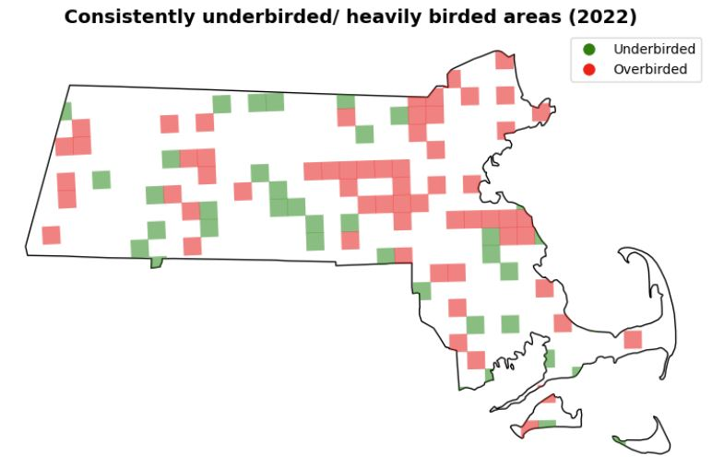
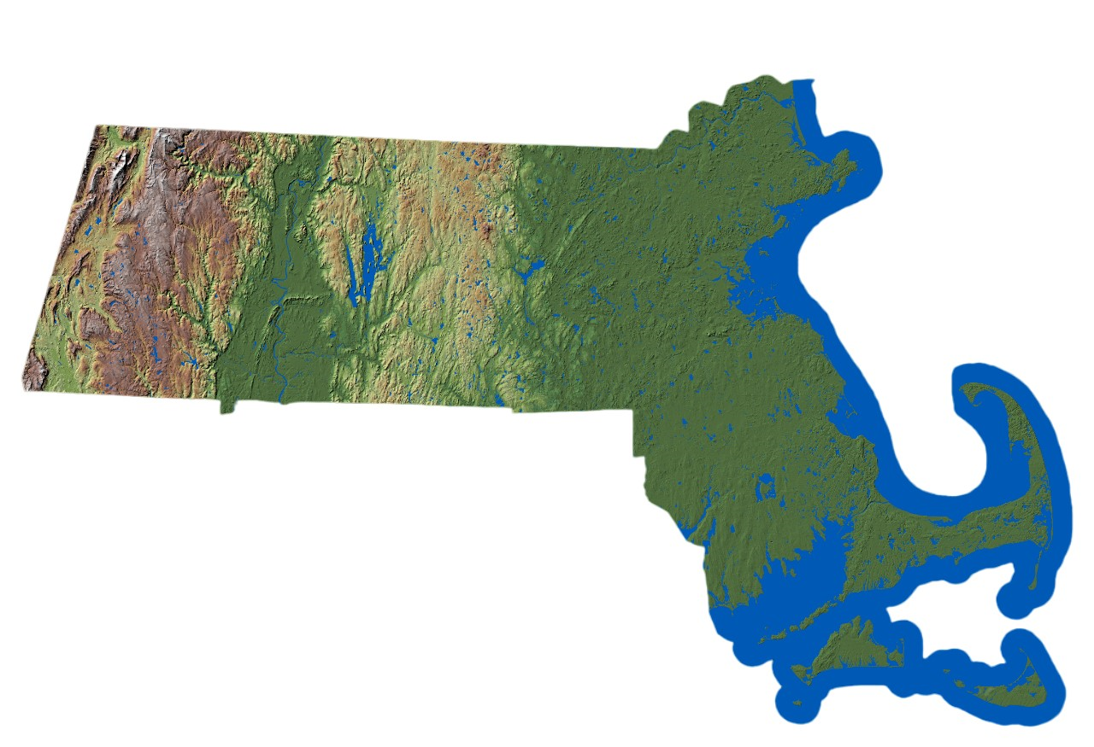
Results
Popular/heavily birded areas identified in coastal, urban, and valley regions, corresponding with populated and accessible regions
Underbirded areas are more scattered geographically and temporally
Fig. Consistently over/under-birded areas in 2022 (left), MA population density map 2010 (upper right), MA topology map (lower right)
Notes:
Nhat
Show category map (stop at month 7):
Heavily birded areas (dark red) and popular areas (light red) don’t change much throughout the years, are mainly in coastal, urban, and valley regions (the Berkshires, Central Mass)
Comparing this with MA’s population density map and topography map reinforced our hypothesis: popular bird watching areas are in densely populated, lower elevation regions, hence more accessible.
Underbirded areas are more dispersed, with some in Southern Worcester (spring fall) and some in Plymouth county (winter summer)
When user clicks into a cell, they can see the metrics and hotspots within that cell

Slide 17
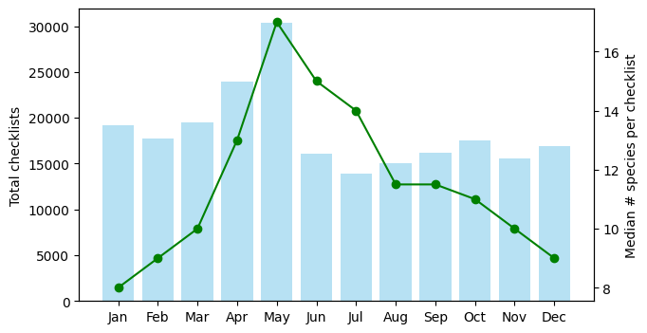
Results
There is a weak correlation between area popularity and number of species (coefficients 0.08 - 0.28) but stronger with rare species sightings (0.34 - 0.61)
Birding activity peaks in May with spring migration
Number of species observed fluctuates yet birding activity is relatively stable throughout the year
Notes:
Nhat
Each key metric is visualized on individual maps. Like the aggregated map, these show high checklist and observer counts predominantly in urban and coastal areas, consistent across all seasons.
The median number of species per checklist varies with location and time.
Notably, coastal areas, despite not always having high species diversity, consistently exhibit regular birding activity (stop at 9), especially in winter.
Coastal regions also tend to attract uncommon species year-round, likely due to diverse habitats and migratory patterns.
Our Spearman correlation analysis showed that the relationship between observer count and species count per checklist is weaker, whereas the correlation between observer count and uncommon species count is notably stronger.
This indicates that rare species sightings are a more significant driver of birding activity than overall species diversity.
This graph shows monthly birding activity in MA. We can see a peak in total checklists in May, coinciding with spring migration when the number of species per checklist is also the highest.
Beside that, the species count fluctuates but birdwatching activities are relatively stable throughout the year.

Slide 18
Discussion
Developed a scalable forecast model with robust accuracy, a streamlined process for data updates and model retraining
Dashboard guides birdwatchers in trip planning and assists habitat managers in monitoring and conservation efforts
Choropleth maps identify overbirded and underbirded regions to balance environmental impact
The tools facilitate comprehensive analysis of bird migration, species diversity, and urbanization effects
Notes:
Neil
Overall, we successfully created a scalable forecast model with robust accuracy, a streamlined pipeline for easy future updates
We built two two user-friendly tools that enhance birdwatching experiences and support habitat management and conservation efforts.
The Tableau dashboard can help birdwatchers of all levels to effectively plan their outings with detailed statistical insights
The maps provide a broader view of birding activity in MA. They highlight underbirded and heavily birded areas, helping to balance birdwatching activity and reduce environmental strain on the popular spots.
The tools can also facilitate future analysis of bird migration, species diversity, and urbanization effects on bird populations

Slide 19
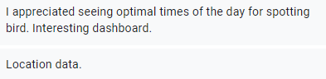
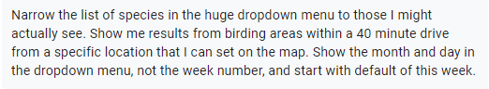
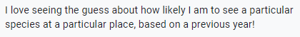
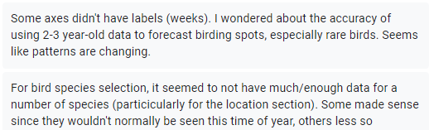
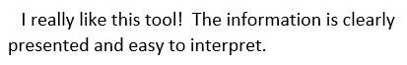
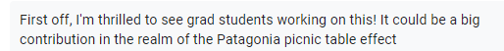
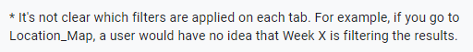
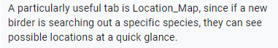
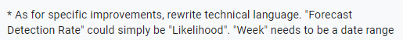
User Feedback
What do you find useful?
How can we improve?
Notes:
Neil
What users found useful:
It was interactive and easy to understand. It also had a lot of useful filters for both location and time that really help narrow down analysis of bird behavior.
What users thought we could improve on:
Jargon could be made easier to understand: for example detection rate could be likelihood. Also, our date filter, instead of being numerical and singular, should be a date range. Finally, there were some comments on improving the general format and layout to make it more intuitive.

Slide 20
Future Work
Explore model scaling through species clustering and hierarchical modeling
Search for high-quality habitat and weather data, integrate into both tools to improve forecast models and enhance understanding of birding activities
Shift to a hotspot-focused approach and include accessibility information to give more practical insights to users
Upgrade infrastructure with cloud solutions for better data hosting and develop a Flask app for centralized access to tools
Notes:
Neil
To enhance and expand the project, several ideas are being explored.
First, to scale the forecast model across states or countries, we can streamline it by clustering similar bird species and regions.
Second, continue to search and integrate weather data of similar granularity with our existing time series data as regressor to the forecast model. Additionally, we want to include information on habitat type, such as wetlands, forest, and condition (land use, ) - this will help improve model accuracy and enhance understanding of birding activities
We also want to explore a hotspot-focused approach and include accessibility info to give more practical insights to users, and go a step further than just county-level information
Finally, an infrastructure upgrade - specifically deploying cloud solutions for enhanced data housing and a flask app for centralized access to tools

Slide 21
References
Cornell Lab of Ornithology. (n.d.). Trends maps. eBird Science. Retrieved November 19, 2023, from https://science.ebird.org/en/status-and-trends/trends-maps
Cornell Lab of Ornithology. (2023). Use eBird data and tools. eBird Science. Retrieved November 3, 2023, from https://science.ebird.org/en/use-ebird-data
Floyd, T., Minardi, R., & Retter, M. L. (2023). ABA Checklist. American Birding Association. Retrieved December 6, 2023, from https://www.aba.org/aba-checklist/
Greykite - A flexible, intuitive and fast forecasting library. (n.d.). LinkedIn Open Source. Retrieved October 16, 2023, from https://linkedin.github.io/greykite/
Khare, P. (n.d.). Understanding FB Prophet: A Time Series Forecasting Algorithm. Medium. Retrieved November 3, 2023, from https://medium.com/illumination/understanding-fb-prophet-a-time-series-forecasting-algorithm-c998bc52ca10
NCEI. (2023). County Time Series | Climate at a Glance. National Centers for Environmental Information. Retrieved December 6, 2023, from https://www.ncei.noaa.gov/access/monitoring/climate-at-a-glance/county/time-series
Trimble, J., & Schain, R. (n.d.). Review List – Massachusetts Avian Records Committee. Massachusetts Avian Records Committee. Retrieved December 6, 2023, from https://maavianrecords.com/review-list/
12.2 Prophet model | Forecasting: Principles and Practice (3rd ed). (n.d.). OTexts. Retrieved October 16, 2023, from https://otexts.com/fpp3/prophet.html

Slide 22
Thank you!
Comments / Questions?
Notes:
Final model
Pipeline
Birding

